Slide 1
Dashboard idea and storyboard

Slide 2
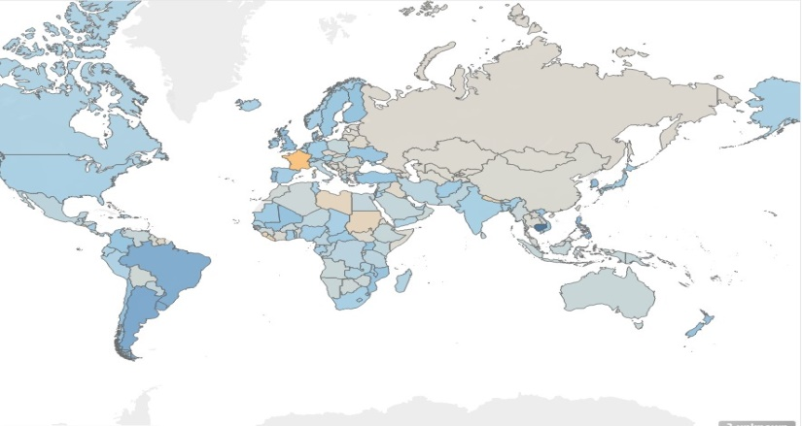
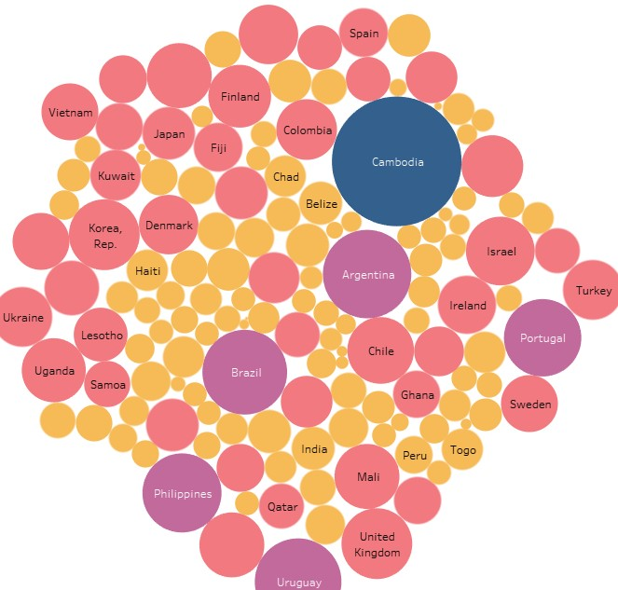
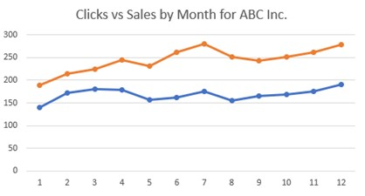
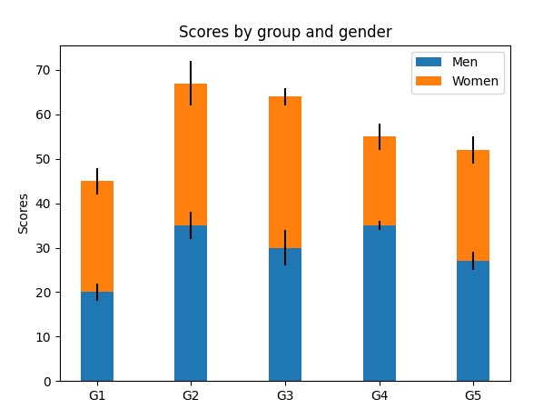
Project Title
Drop
Control field
Drop

Slide 3

Project Title
Drop
Control field
Drop

Slide 4
Story board
On startup a user first sees the world map of 2021 or latest data
Map shows average value heat map with legend on the side
Control panel has drop down and radial buttons
Panels get updates by country and year

Slide 5
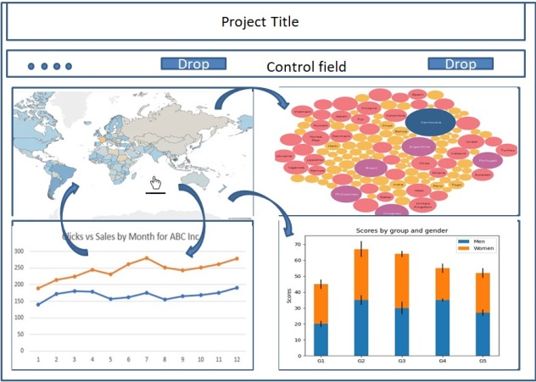
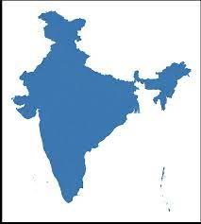

Slide 6
Features
The world map lets us drag move, zoom, click
Other windows can have interactivity like tooltips and selection on time scale line graph

